Slide 1


Python Games: Unlock the Fun!
This project is a collection of engaging Python-based games designed for entertainment and educational purposes. It includes Tic-Tac-Toe, a strategy game to enhance logical thinking; Word Scramble, which improves vocabulary and cognitive skills; Odd or Even, a guessing game to boost decision-making; and Math Quiz, which helps reinforce basic arithmetic abilities. Built using the Tkinter library, these games feature user-friendly interfaces and interactive designs, making them suitable for learning programming concepts, practicing problem-solving
Submitted By:Harshit Chauhan(23csu363)
Saksham Parmar(23csu367)

Slide 2
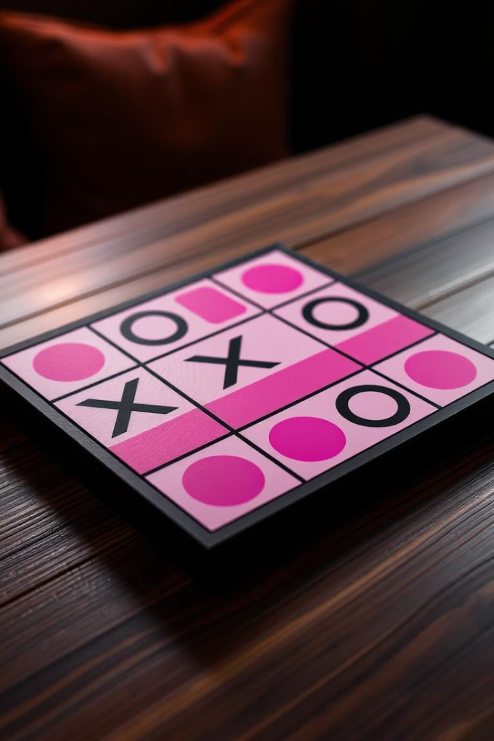
Objective: Two players take turns to place X or O in a 3x3 grid.
Logic:
Check if a player wins after each move.
Switch player turn after each move.
Display winner or draw message.
Tic Tac Toe: Mastering the Classic
1
Strategize
Analyze the board and plan your next move to outmaneuver your opponent.
2
Anticipate
Foresee your rival's potential plays and develop countermoves to stay one step ahead.
Objective: Two players take turns to place X or O in a 3x3 grid.
Logic:
Check if a player wins after each move.
Switch player turn after each move.
Display winner or draw message.
3

Slide 3
Word Scramble: Unscramble the Challenge
Expand Vocabulary
Boost Concentration
Compete with Friends
Objective: Unscramble the given word.
Logic:
Select a random word and scramble it.
Prompt user to guess the word.
Check if the user’s guess is correct.
Unscrambling word puzzles helps players enhance their language skills and discover new words.
Multiplayer word scramble games allow you to challenge your friends and see who has the sharpest mind.

Slide 4

Math Quiz: Putting Your Skills to the Test
1
Improve Numeracy
2
Challenge Yourself
Math quiz games help players strengthen their mathematical abilities and problem-solving skills.
Progressing through increasingly difficult math questions pushes players to expand their knowledge.
Objective: Solve a simple math question (e.g., addition).
Logic:
Generate random math question.
Prompt user to input the answer.
Check if the answer is correct.
3

Slide 5

Odd Even Trivia: Test Your Knowledge
Sharpen Logic
Discover Patterns
Odd even trivia games challenge players to think critically and apply logical reasoning.
Identifying patterns in odd and even numbers helps develop numerical intuition.
Objective: Guess if the random number is odd or even.
Logic:
Generate random number between 1 and 100.
Let user choose "Odd" or "Even".
Check if user’s guess matches the number type.
Competitive Edge
Testing one's knowledge against others in odd even trivia fosters a spirit of friendly competition.

Slide 6
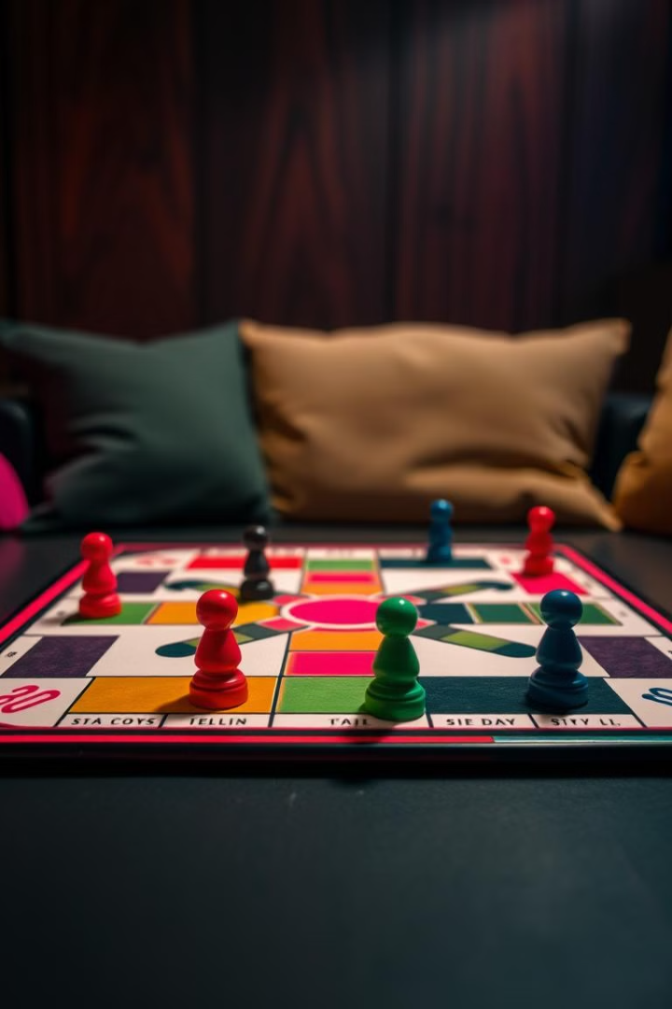



Ludo: The Timeless Board Game
Chance
Strategy
The roll of the dice adds an element of unpredictability and excitement to the game.
Players must carefully plan their moves and anticipate their opponents' actions to gain an advantage.
Objective: Roll a dice to get a random number between 1 and 6.
Logic:
Simulate rolling a dice.
Display the result to the user.
Competition
The competitive nature of Ludo encourages players to outmaneuver each other and emerge victorious.

Slide 7
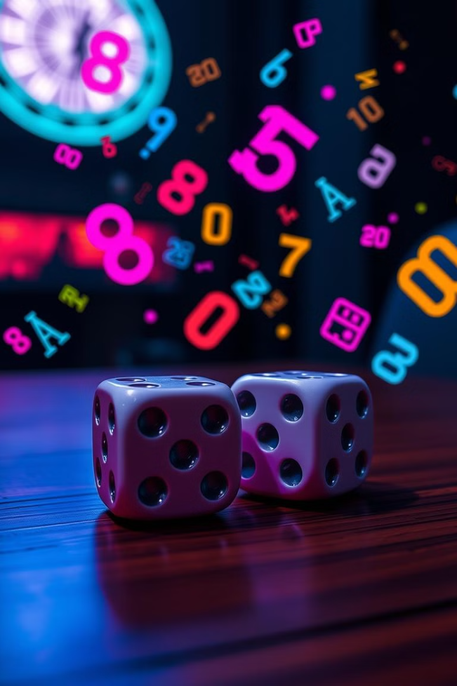



Dice Roll and Add: Chance Meets Calculation
Roll the Dice
The thrill of the dice roll introduces an element of chance and randomness to the game.
Perform Calculations
Players must quickly add the values shown on the dice, testing their math skills.
Objective: Answer general knowledge questions.
Logic:
Present a random question.
Prompt user to input the answer.
Check if the answer is correct.

Slide 8



CONCLUSIONS FOR ALL THESE PYTHON CODES
Engaging Visuals
Seamless Interactivity
Collaborative Play
Python games can incorporate stunning graphics and animations to captivate players and enhance the overall experience.
Python's versatility allows for the creation of games with intuitive controls and seamless user interactions.
Many Python games offer multiplayer modes, enabling friends and family to compete or cooperate in engaging experiences.

